Slide 1


Slide 2


A new way for heart monitoring

Slide 3

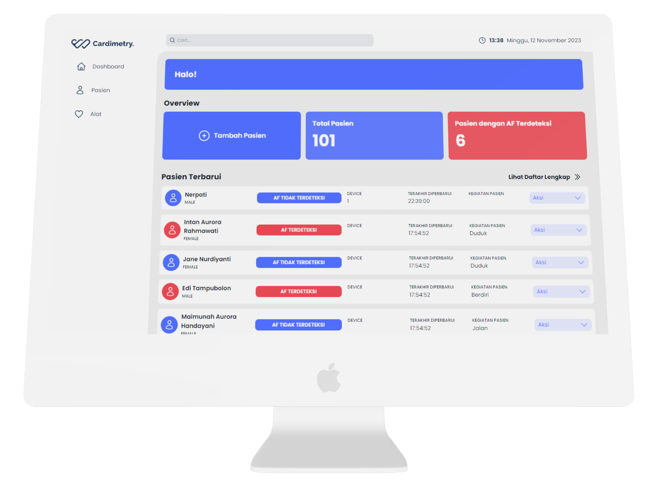
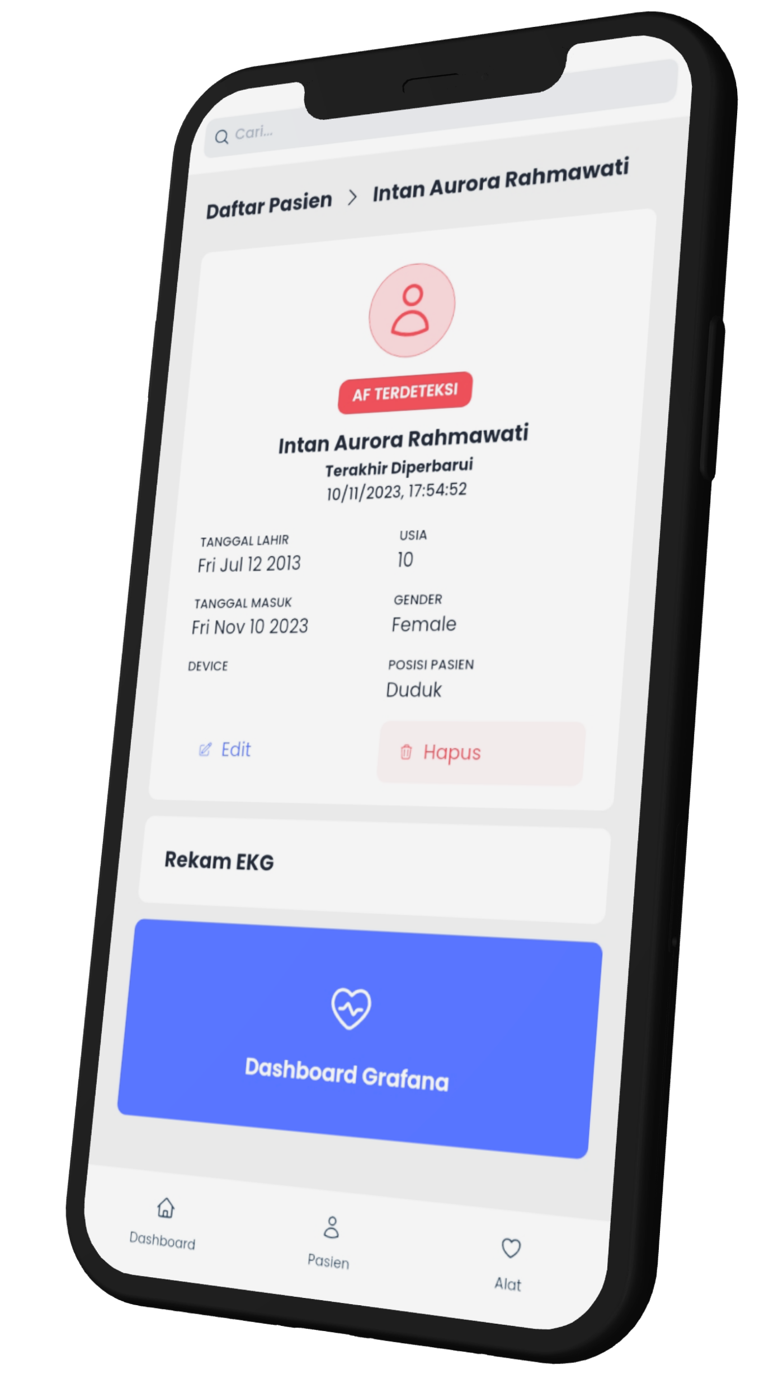
Real-time
dashboard

Slide 4
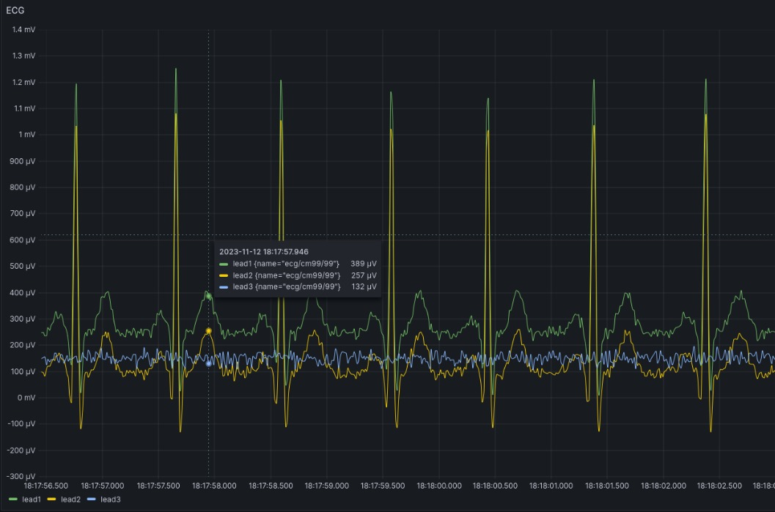
ECG monitor
with
AF detection

Slide 5
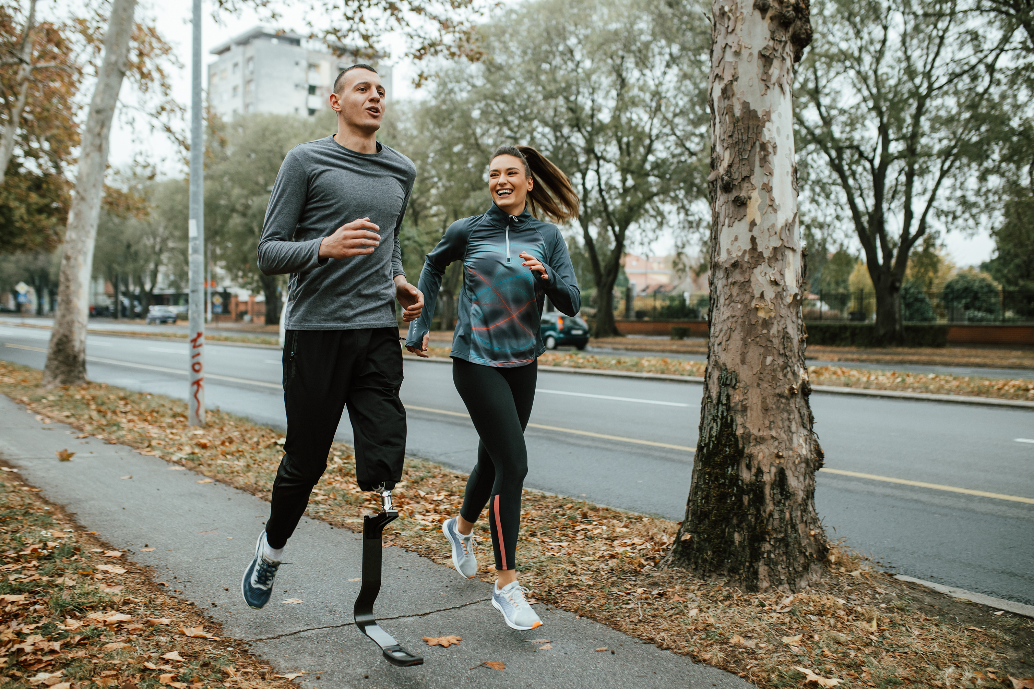
AI-based
activity
recognition

Slide 6
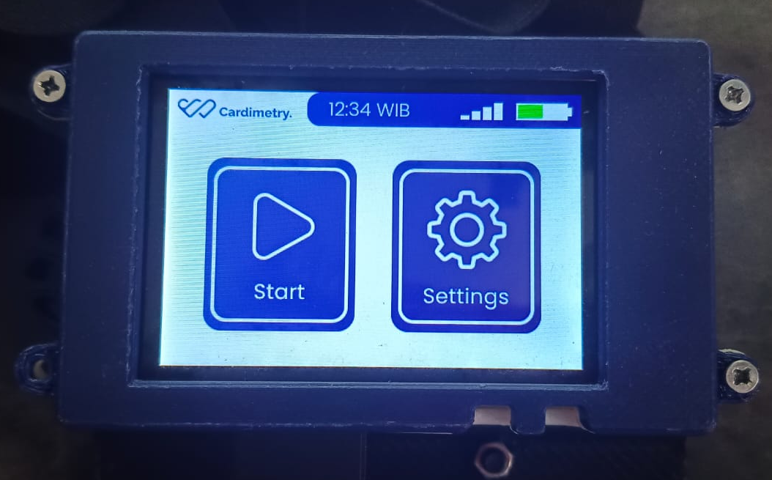
Wearable
device with
touchscreen
display

